Slide 1
FALCON & FALCON-Unzip
For phased diploid genome assembly of PacBio SMRT reads
Chin et al., 2016
Notes:
PacBio conflict of interest Specifically for long SMRT reads from PacBio, but probably good with other long reads.

Slide 2
Phased Diploid Genome Assembly
Distinguish alleles and SNPs of homologous chromosomes
Why phase?
Capture heterozygosity present within a diploid or polyploid species
Detect differences in sequence, structure, and gene presence between homologous chromosomes
Trace disease inheritance from parental chromosomes

Slide 3
Useful definitions
Haplotype (haploid genotype) block – block of contiguous sequence inherited together from a single parent (i.e. a block of sequence from one homologous chromosome)
Phasing – assigning sequence variants to the correct haplotype
Contig - set of overlapping segments that together represent a consensus sequence region
Primary Contig - backbone contig for both haplotypes
Alternative Contig – local alternative sequences to the primary contig, prior to SNP phasing step
Haplotig (haplotype contig) – a phased contig, generated after phasing and unzipping steps

Slide 4
Overview
Notes:
Two parts:
FALCON, for diploid-aware long-read assembly
FALCON-Unzip, for resolving the haplotype of a haplotype-fused assembly

Slide 5
FALCON
Diploid-aware long-read assembler
FALCON-Sense
Myers’ Algorithm
Graph reduction
Raw long reads
Consensus read sequences
daligner
Read overlaps
Directed string graph
Haplotype-fused assembly graph

Slide 6
FALCON-sense for read consensus calling
Align supporting reads to seeding sequence using variation of Myers' O(ND) aligner
No mismatches allowed – differences coded as insertions and deletions
seed: ATATTAGGC
read 1: ATATACGGC
read 2: ATATACGGC
read 3: ATCATCCGGC
align
align
align
seed = | ATATTA-GGC
read 1 = | ATAT-ACGGC
seed = | ATATTA-GGC
read 2 = | ATAT-ACGGC
seed = | AT-ATTA--GGC
read 3 = | ATCAT--CCGGC
Notes:
FALCON-Sense – generate consensus for each seeding sequence
Confusing – not sure how they pick the seeds!
First step: align supporting reads to seeding sequence using a variation of Gene Myers' O(ND) aligner (Myers 1986) – the original algorithm for the unix ’diff’ utility

Slide 7
FALCON-sense for read consensus calling
2. Generate tag for every position of each alignment
Tag format:
anchoring position p : delta from anchor d : seed base : supporting read base
p = | 0123455678
d = | 0000001000
seed = | ATATTA-GGC
read 1 = | ATAT-ACGGC
p:d:s:r
0:0:A:A

Slide 8
FALCON-sense for read consensus calling
3. Generate alignment graph from all alignment tags of all supporting reads
5:2:-:C
1
1
1:1:-:C
5:1:-:C
1
1
3
2
3
2
3
3
3
3
3
0:0:A:A
1:0:T:T
2:0:A:A
3:0:T:T
4:0:T:-
5:0:A:A
6:0:G:G
7:0:G:G
8:0:C:C
p = | 0123455678
d = | 0000001000
seed = | ATATTA-GGC
read 1 = | ATAT-ACGGC
p = | 0123455678
d = | 0000001000
seed = | ATATTA-GGC
read 2 = | ATAT-ACGGC
p = | 011234555678
d = | 001000012000
seed = | AT-ATTA--GGC
read 3 = | ATCAT--CCGGC
Notes:
Create a node in the graph for each distinct tag
For consecutive tags from a supporting read, create an edge in graph and assign edge_count. If edge_count already exists, increment by 1. edge_count gives you a measure of confidence about connection between nodes
Result: directed acyclic graph

Slide 9
FALCON-sense for read consensus calling
4. Generate consensus sequence by concatenating the bases of tags through the best path
5:2:-:C
1:1:-:C
5:1:-:C
0:0:A:A
1:0:T:T
2:0:A:A
3:0:T:T
4:0:T:-
5:0:A:A
6:0:G:G
7:0:G:G
8:0:C:C
seed = | ATATTAGGC
read 1 = | ATATACGGC
read 2 = | ATATACGGC
read 3 = | ATCATCCGGC
read consensus = | ATATACGGC
Notes:
A standard dynamic programming algorithm is applied on the alignment graph to find the highest confidence path.
Generate the consensus sequence by concatenating the bases of the tags through the best path.

Slide 10
daligner for finding read overlaps
a
d
c
b
c
b
a
d
e
e
f
f
Notes:
For error-corrected consensus reads, use daligner to find overlaps
Local aligner, won’t go into algorithm here
An overlap-filtering step is applied to remove contained reads or reads that appear to be from high copy repetitive regions

Slide 11
String graph
An overlap-layout-consensus graph with transitive edges removed
Nodes are reads, and edges represent overlaps between reads
Genome is then assembled by deciphering a feasible layout of reads from the graph
Good for long reads
Notes:
Next construct a string graph based on the read overlaps
A string graph is…
As opposed to de Bruijn graph, where nodes are k-mers, and edges indicate that the adjacent k-mers overlap by exactly k − 1 letters

Slide 12
Directed string graph construction
Myer’s Algorithm
transitive edges removed
𝜸
c.end
𝜸
d.end
d
c
β
β
b
a.end
𝜶
b.end
a
𝜶
e
𝜹
𝜹
f
e.end
𝜺
f.end
𝜺
Notes:
Taking the reads whose overlaps have already been found, create string graph using Myers’ Algorithm (different Myers from the alignment)
Here just showing for the right side overhangs of this branch point
Nodes are ends of reads
Edges are overhangs
Transitive edges removed – fewest possible edges but with the same reachability as the original graph
Blue – primary contig
Red
“Each pair of overlap actually creates two directed edges. However, we only trace the graph along one direction to represent both contigs and their reverse complement Counterpart”

Slide 13
Graph reduction
Decompose string graph into compound and simple paths
Simple path – path through a subset of the graph with no internal branching nodes
Compound path – collection of edges that represents a bubble with a unique source and sink node

Slide 14
Graph reduction
“Empirically derived heuristic methods”
Consecutive edges without branching nodes are grouped to become a single edge
simple path
v

Slide 15
Graph reduction
“Empirically derived heuristic methods” to identify bubbles in the string graph
2. Use nodes with >1 out edge to identify bubbles
v
compound path
Notes:
Set up tracers to identify bubbles
Remove nested bubbles, loops, tangled nested bubbles
If nested bubble, take the larger bubble and ignore the smaller one

Slide 16
Haplotype-fused assembly
3. Combine simple and compound paths to form haplotype-fused assembly graph
Haplotype-fused assembly graph
4. Separate graph into primary and associated contigs
Primary contigs are still haplotype-fused
associated contigs
primary contig
Notes:
Associated contigs “have a large number of variations relative to the primary contigs”
Primary contigs are still haplotype fused, meaning different parts may still come from different haplotypes

Slide 17
FALCON-Unzip
Haplotype resolving
SNP Phasing and BLASR
FALCON-Unzip
Phase-annotated string graph
Quiver
Consensus phased diploid assembly
Haplotype-fused assembly graph
Phased PacBio Reads

Slide 18
Re-map raw reads
For phasing, need to re-map all raw-read-to-contig associations
Trace contigs to find where a raw read is most likely to be associated
BLASR aligner
associated contigs
primary contig
Notes:
In the haplotype-fused assembly, each contig is just a tiling sequence from the subsequences of a set of error-corrected reads
Some of the raw reads haven’t been associated with any contigs yet
In order to do the phasing, need to identify all raw-read-to-contig associations by tracing the contigs to find where each read is most likely to be associated using BLASR aligner, which is the original PacBio aligner
Reads get grouped into sets associated with each contig

Slide 19
Call heterozygous SNPs
Examine bases at each position in the contig
Het-SNP is called if base with highest count <75% and base with second-highest count >25%
Top two bases are used as the two alleles
contig
A
A
A
reads
G
G
T
Het-SNPs for this position: A,G

Slide 20
Phase – assign SNPs to haplotypes
Notes:
Randomly initialize phases for each het-SNP site
For any pair of sites that have shared reads mapped on, calculate the coupling score, which is the number of reads that support that particular phase. Keep the phase with the better coupling score.
Use a greedy flipping phase assignment algorithm that scores and flips het-SNPs until scores are optimized.
The output is groups of het-SNPs along the reference that are grouped into different haplotype blocks
Panel (d) shows a the coupling scores for a block of the genome before and after phasing

Slide 21
Unzipping
Incorporate phased reads to haplotype-fused string graph for unzipping collapsed paths
Notes:
Once you have the phased haplotype blocks from the phasing step, you merge those to the haplotype-fused assembly graph (in yellow) to generate an intermediate graph.
Then remove the edges that occur between the different phases to disconnect the two haplotypes.
At the same time, you also go back and assign phases to raw reads, then use the phased reads to construct tiling paths for the two haplotigs that were generated.

Slide 22
Quiver algorithm
Remove residual errors in the haplotig consensus from the haplotype-specific alignments
Notes:
Apply Quiver to the tiling paths of the haplotigs to get an accurate consensus sequence for each haplotype

Slide 23
FALCON-Unzip Example
Notes:
Example of primary contig and haplotig construction for C. pyxidata genome assembly
Along the initial primary contig, there are 4 haplotype blocks and an un-phased region (unphased because not enough coverage or heterozygosity).
FALCON-Unzip brings back back some reads to fully reconstruct haplotigs.
Then remove edges connecting the separate haplotypes
The four initial blocks for each haplotype are then merged into one major haplotig each – the red and the blue

Slide 24
Recap
FALCON – A diploid-aware long-read assembler
FALCON-Sense
Myers’ Algorithm
Graph reduction
Raw long reads
Consensus read sequences
daligner
Read overlaps
Directed string graph
Haplotype-fused assembly graph
FALCON-Unzip – Haplotype resolver
SNP Phasing and BLASR
FALCON-Unzip
Phase-annotated string graph
Quiver
Consensus phased diploid assembly
Haplotype-fused assembly graph
Phased PacBio Reads

Slide 25
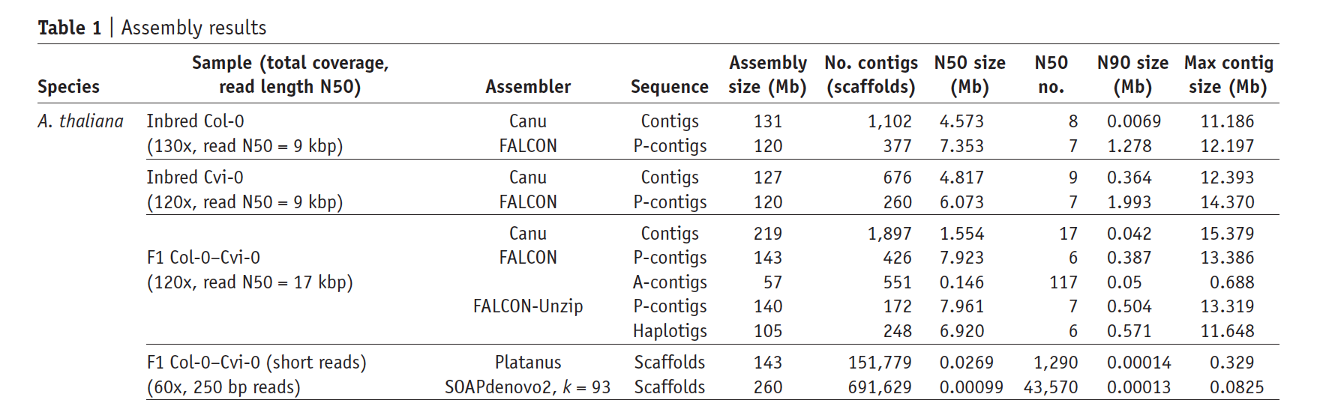
Performance
Essentially
haploid
Long-read assembly
Diploid hybrid
200
245
Short-read
assembly
TAIR10 reference: 238Mb diploid assembly size
Notes:
Explain diploid, inbred(haploid)
Diploid assembly capture
Total contig size and number of contigs

Slide 26
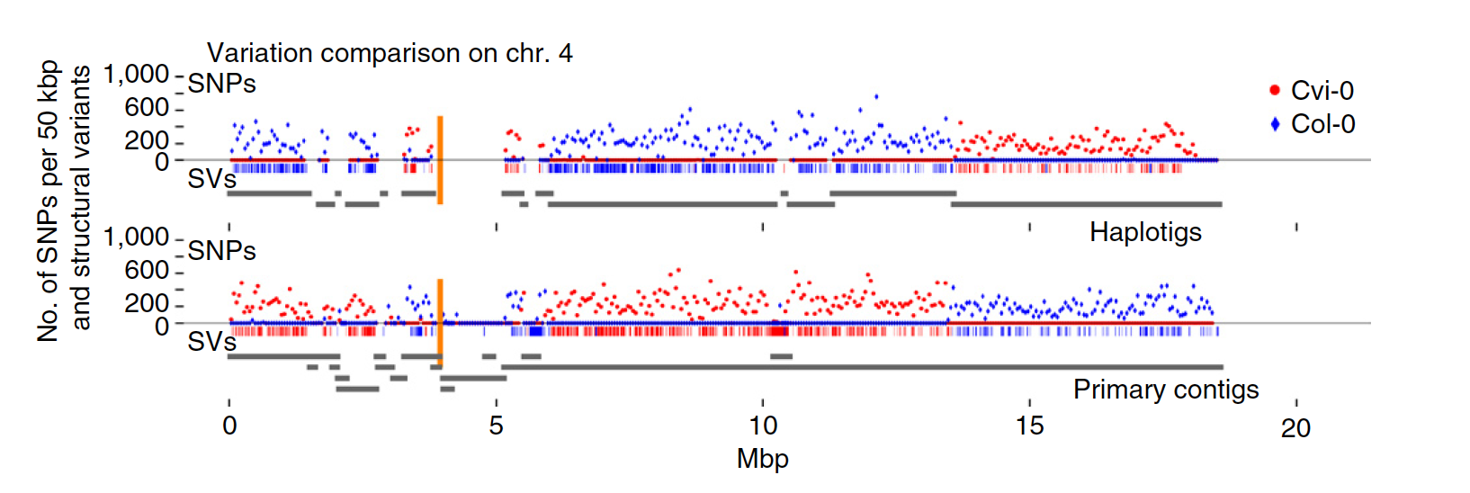
Performance
Notes:
-Aligned p-contigs and haplotigs to the parental inbred assemblies to see how accurate the haplotype separations are.
-Ideally, each haplotig should be identical to one of the parental haplotypes and vary completely from the other.
-Most of the haplotigs only showed SNPs or SVs in one of the parental genomes, which means it works well
No mention of time or memory footprint efficiency?

Slide 27
Notes:
end

Slide 28
Notes:
Just making the point that for regions with differing levels of heterozygosity, the contig layouts will be different.
To separate the haplotypes reliably, there must be enough coverage to call het-SNPs with random sequence error: so only call het-SNPs on positions with coverage > 10.
Also must be enough het-SNPs within the read lengths, so if a read covers less than two het-SNPs or neighboring het-SNPs are too distant, not enough overlaps -> can’t build haplotype.

Slide 29
Overall FALCON schematic

